Slide 1
Blast Injury
Martin R. Eichelberger, M.D.
Triaj Inc.
Annapolis, Maryland
Professor of Surgery and Pediatrics
Children’s National Medical Center
Washington, D.C.
11-21-20

Slide 2
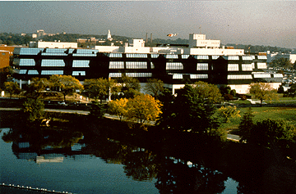
Children’s National Medical Center
Notes:
MRE

Slide 3
Physiology
Avoid: Hypothermia
Acidosis
Hypocoagulation
Rx 1. Stop bleeding
2. Damage control
Outcome Less fluid
lung injury

Slide 4
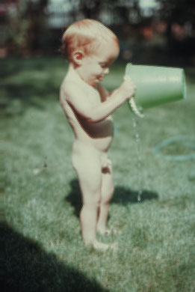
Notes:
MRE

Slide 5
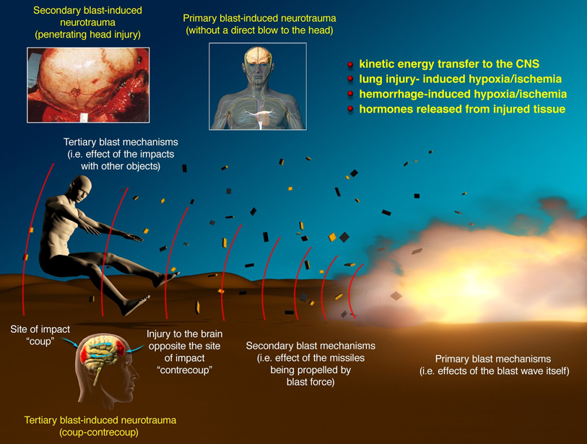
Notes:
Primary, secondary, tertiary, quaternary injury
Traumatic brain injury: an overview of pathobiology with emphasis on military populations
Ibolja Cernak1 and Linda J Noble-Haeusslein2
¹National Security Technology Department, Johns Hopkins University Applied Physics Laboratory, Laurel, Maryland, USA
²Department of Neurological Surgery and Department of Physical Therapy and Rehabilitation Science, University of California, San Francisco, California, USA
Correspondence: Dr I Cernak, National Security Technology Department, Johns Hopkins University, Applied Physics Laboratory, Biomedicine Burinus Area, 11100 Johns Hopkins Road, Mail Stop MP2 N108, Laurel, MD 20723, USA. E-mail: ibolja.cernak@jhuapl.edu
Journal of Cerebral Blood Flow & Metabolism (2010) 30, 255–266; doi:10.1038/jcbfm.2009.203; published online 7 October 2009

Slide 6
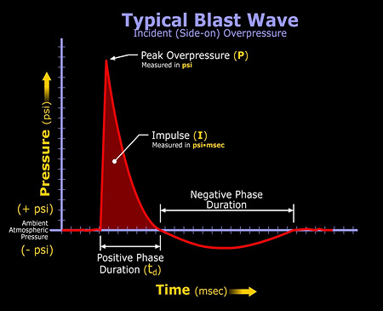
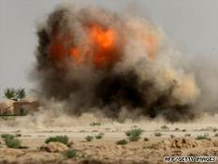
Onda de Explosão Típica
Notes:
Idealized blast wave form: overpressure, followed by underpressure

Slide 7
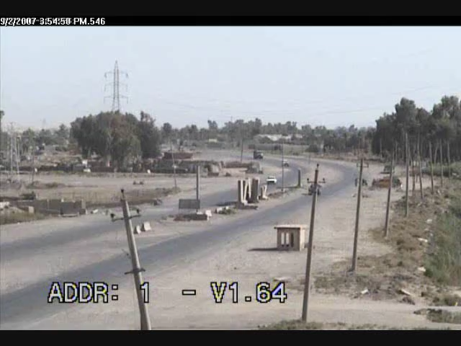
IED

Slide 8
Mechanism of Injury
Primary: | Barotrauma | TM, Lung, Eye, Concussion
Secondary: | Penetrating | Amputation, Lacerations, Concussion
Tertiary: | Blunt | Crush, Compartment syndrome
Quaternary: | Burn, Inhalation | Burns, Toxic gas, Environmental
Quinary: | Bacteria, Radiation

Slide 9
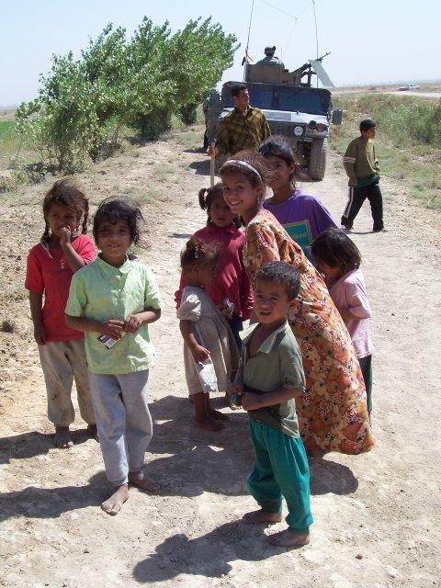
Notes:
Coppola

Slide 10
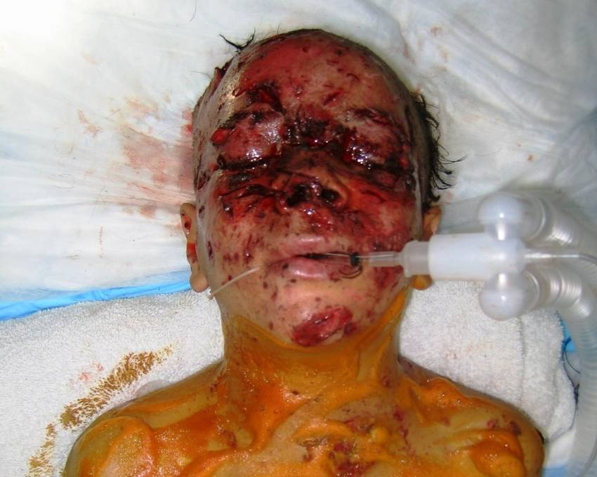
Notes:
Coppola

Slide 11
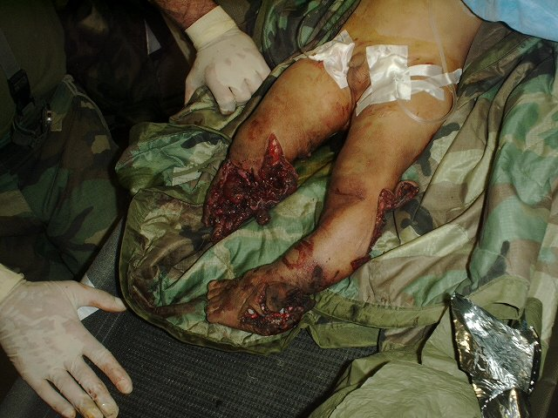
Notes:
11

Slide 12
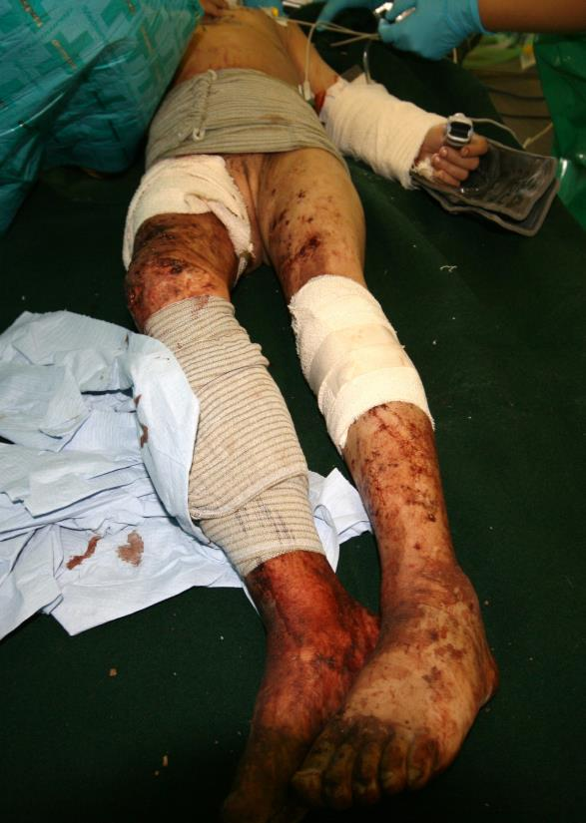
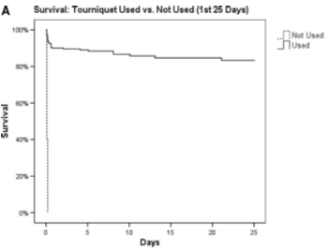
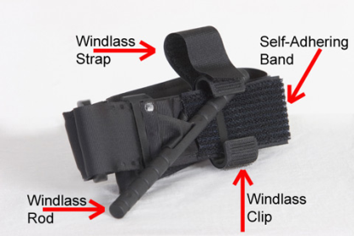
Touniquet
Tourniquet ¹
No Tourniquet!
Save Lives
No Increase in Amputations
¹Kragh, et al. Ann Surg 249(1):1, 2009
Notes:
Now a word on tourniquets related to vascular injury.
First, if they are put on in the field, I typically consider that a sign of vascular injury and typically remove it in the OR where I am ready to gain vascular control.
Second, if the patient has a vascular injury in an extremity and are bleeding profusely, I have applied these tourniquets in the trauma bay to facilitate their resuscitation.
Now this is a very VERY important point made by one of our panelists in this recent article in the Annals of Surgery—tourniquets save lives

Slide 13
Circulation
Adult
      Whole blood – Best
      1 PRBC : 1 FFP : 1 Platelets
Child
      Whole blood – 20 cc/kg
      10 cc/kg PRBC : 10 cc/kg FFP : 10 cc/kg Platelets
Volume limited / Product Resuscitation

Slide 14
Airway
Inhalation Intubation, bronchoscopy
Tracheotomy: avoid
Missed Injury Delay: dysphagia (12 hr)
Respiratory Rate
24 hr observation
Bronchoscopy
Intubation

Slide 15
Breathing
Breath Pneumothorax Bilateral chest tubes
sounds No CXR
BP Immediate Rx Bilateral chest tubes
No CXR
Delay = Death

Slide 16
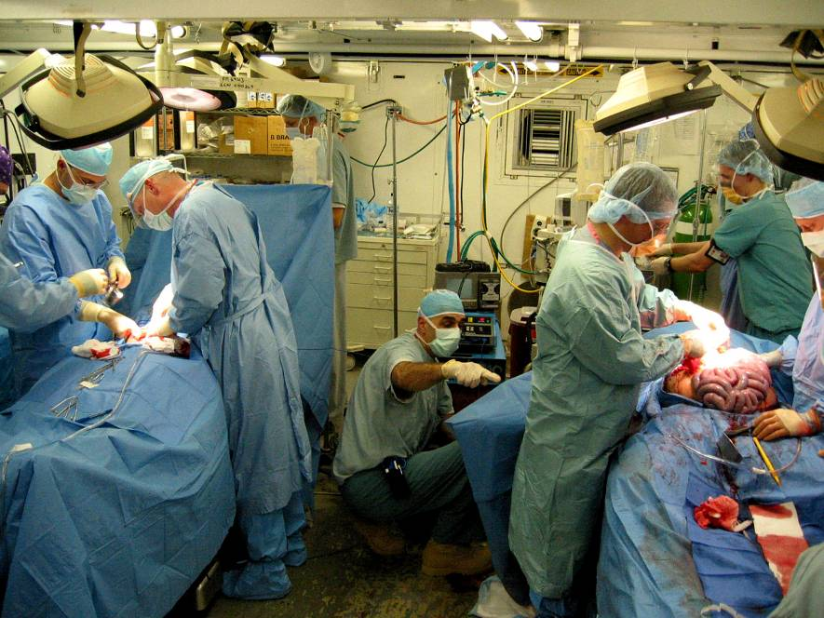
Notes:
Coppola

Slide 17

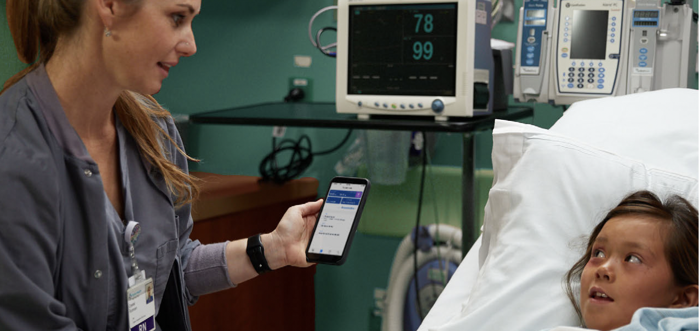


SAVE CHILDREN’S LIVES WITH JUST-IN-TIME CARE
3

Slide 18
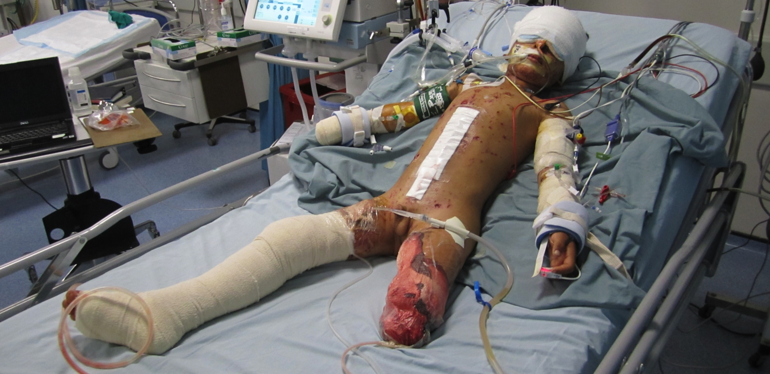
Blast/Explosion Injury

Slide 19
Head
Etiology Barotrauma, Penetrating
CT Worse than appears
Pitfall Delayed swelling 48-72 hr
BP CPP – maintain
Surgery Craniectomy
Dural expansion
Irrigation

Slide 20
Resuscitation
Hypertonic Saline – 3%
    1 cc/kg bolus
    ≥ 145 mEq/L serum sodium
Mannitol – Acute herniation
    0.25-1 gm/kg
    < 320 serum osmolality
Craniectomy – Early: ICP

Slide 21
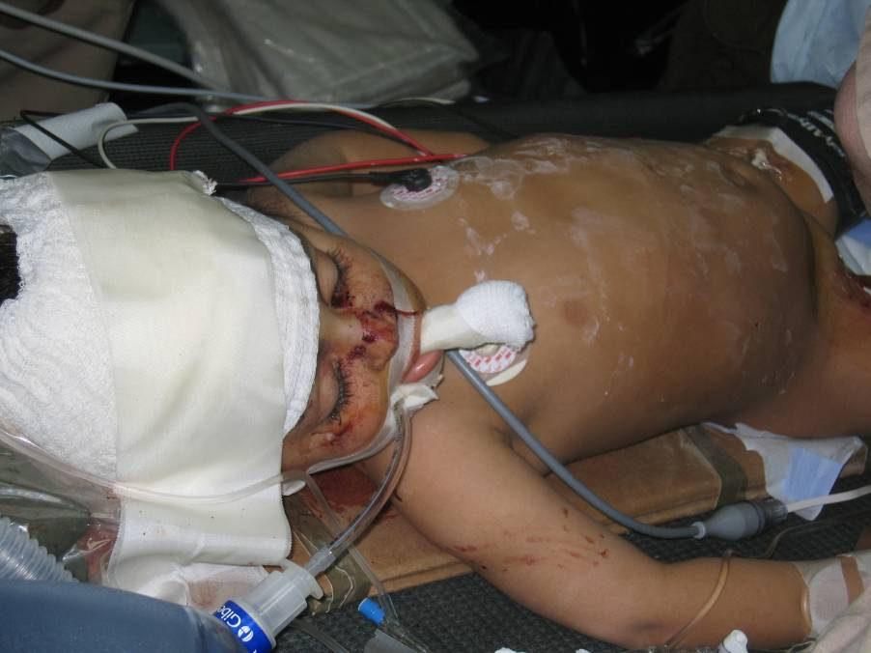
Notes:
3yo blast fragment to head – Azarow
This was labelled GSW but as you can see from the CT it is a fragment from a blast. This was actually an Iraqi physician's child who was invovled in a blast injury. We have permission to show. The physician actually got her son shipped to the states for rehab because she knew there was none available.

Slide 22
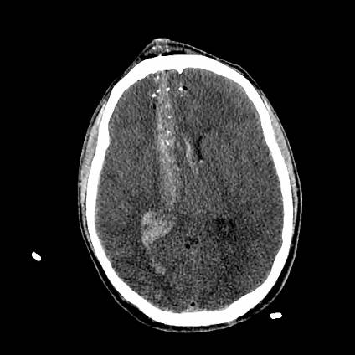
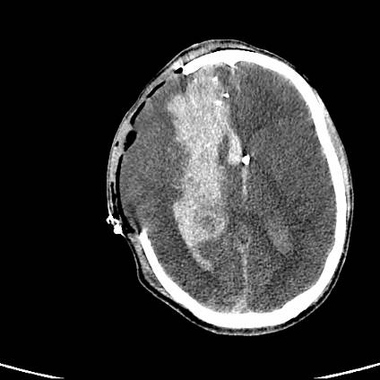
Blast
Notes:
22
Coppola

Slide 23
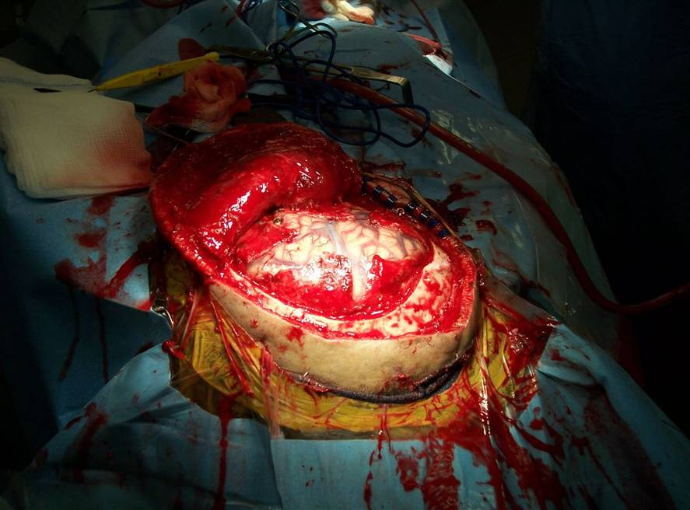
23
Notes:
Coppola

Slide 24
Pulmonary
Etiology Edema, hemorrhage, alveolitis
Ventilation Pressure PEEP between 10 and 15
Tidal volume 6-8 mL/kg
Sedation
Neuromuscular blockade
Oscillation pressure: stop hemorrhage

Slide 25
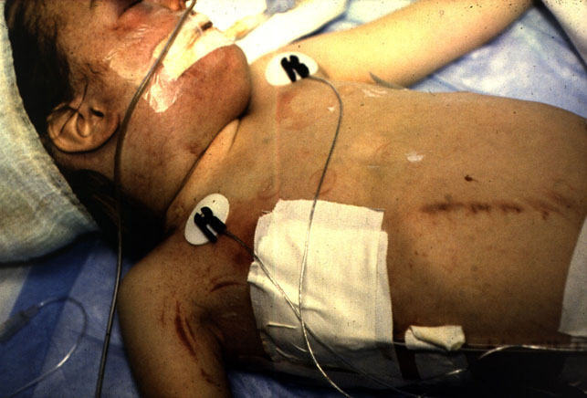
Notes:
25

Slide 26
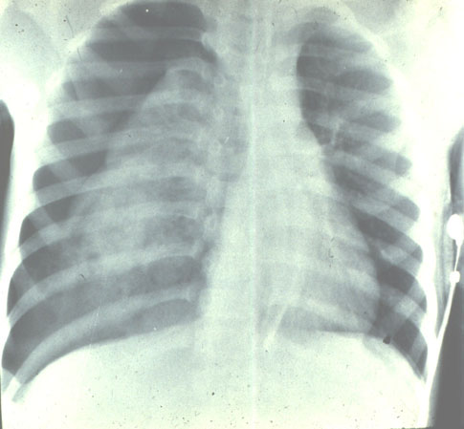
Notes:
26

Slide 27
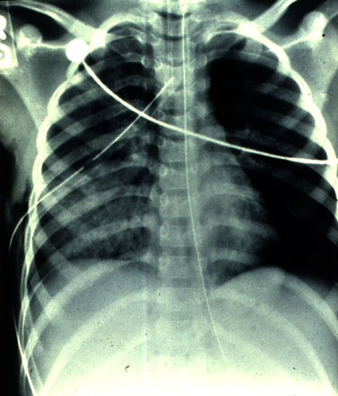
Notes:
27

Slide 28
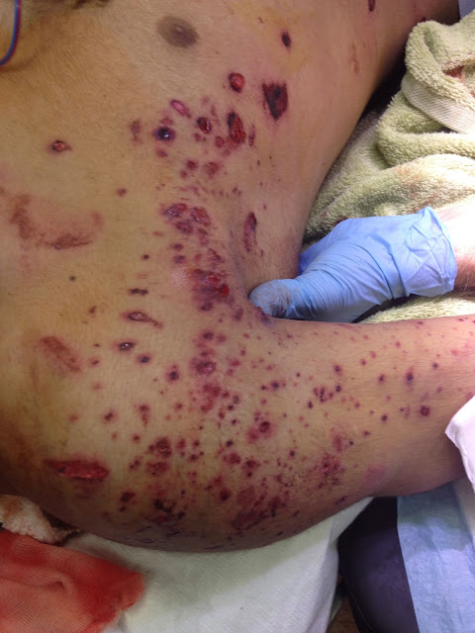
Notes:
Peppering across chest wall seen with shrapnel from blast injury – how to address

Slide 29
Pulmonary Injury
Delayed Presentation
Primary blast injury – barotrauma
Inhalation: smoke, noxious chemical
Massive resuscitation
Transfusion – blood product

Slide 30
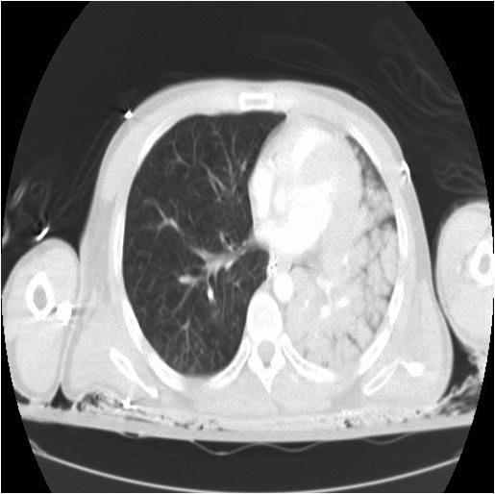
Notes:
Unilateral injury causes shunt through diseased lungs
Submissive hypoxemia
Differential lung ventilation

Slide 31
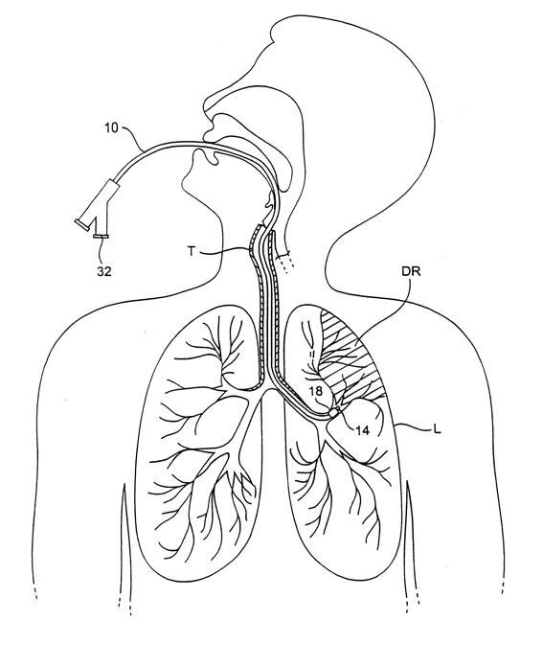
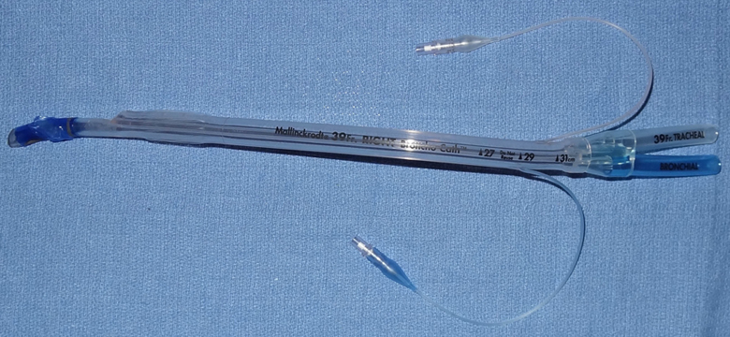
Notes:
Double lumen endotracheal tube for lung isolation
It isnt fun or easy, but it might work
Difficulty suctioning / clearing secretions due to smaller lumen size

Slide 32
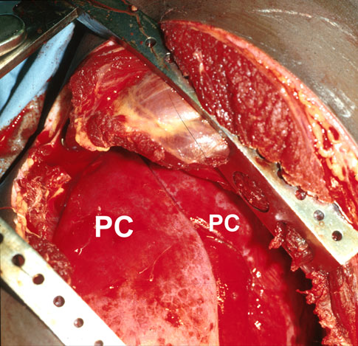
Notes:
Contused lung

Slide 33
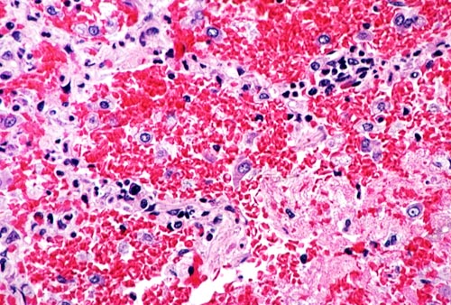
Notes:
Alveolar hemorrhage
http://pathhsw5m54.ucsf.edu/overview/interstitial9.html

Slide 34
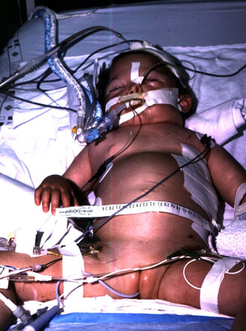

Slide 35
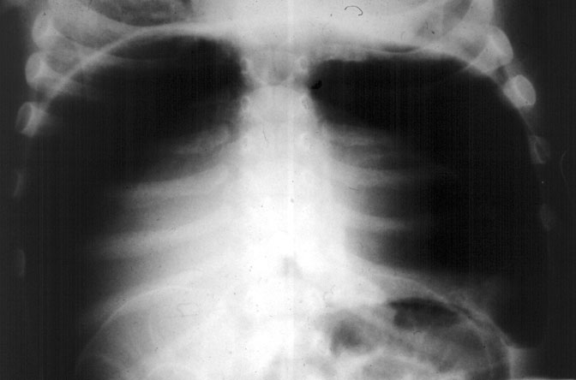

Slide 36
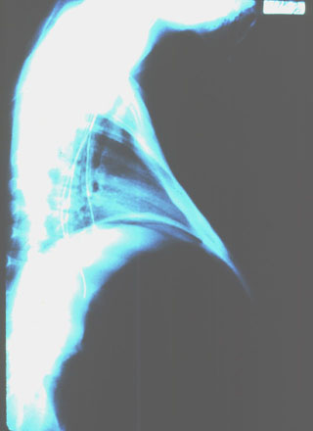

Slide 37
Abdomen - Principles
FAST Common
CT Rare
Colostomy Always
Enterotomy Repair risk
Duodenal Exclusion
Drainage

Slide 38
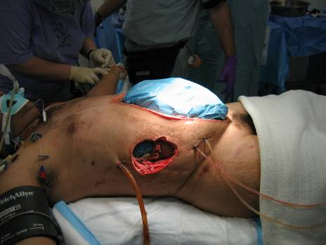
Notes:
Coppola

Slide 39
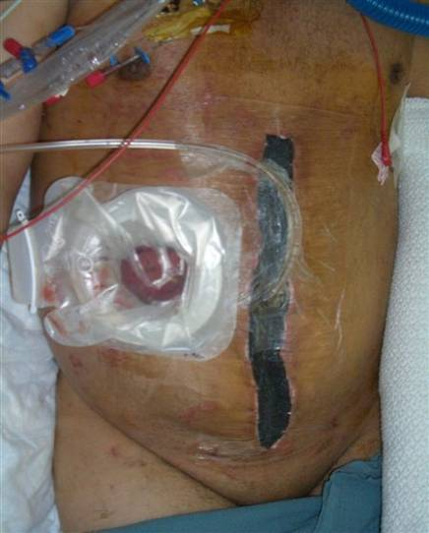
Abdominal Closure
Notes:
Coppola

Slide 40
Extremity
Mangled Amputate
ORIF “Fix”
Femur Ex-fix, transfer
Upper extremity Ex-fix: temporary
Plate
Soft tissue cover

Slide 41
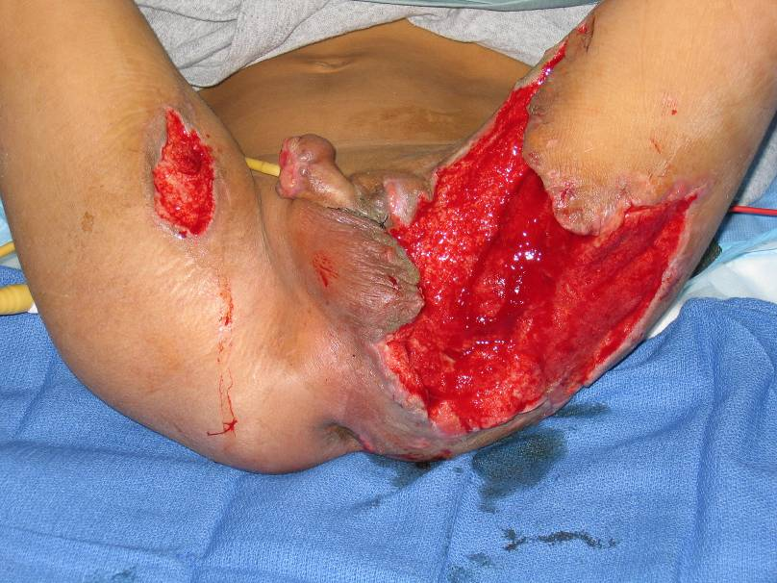
Notes:
7yo IED – perineal blast injury (Azarow)
perineal blast injury(these are about 2- months into his course: urethral injury, scrotal and rectal injury, bad perineal burn. Pt 8 years old and great hand off between 3 surgeons (I was the 2nd surgeon in the sequence) - I have permission from the boy's dad to show these. He allowed my successor to take the final picture in followup .

Slide 42
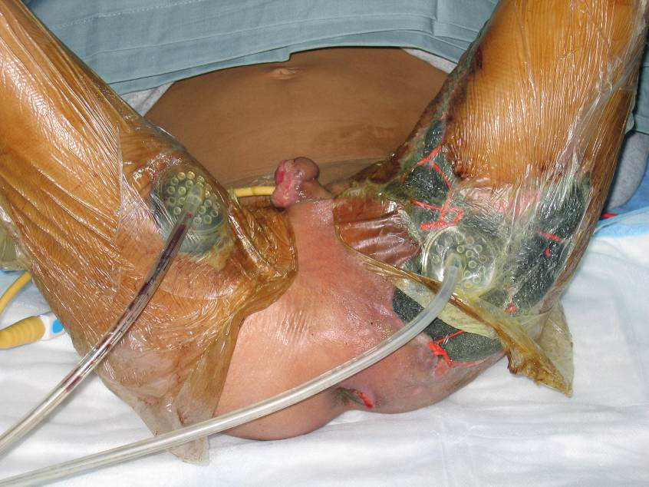
Notes:
7yo IED – perineal blast injury (Azarow)
perineal blast injury(these are about 2- months into his course: urethral injury, scrotal and rectal injury, bad perineal burn. Pt 8 years old and great hand off between 3 surgeons (I was the 2nd surgeon in the sequence) - I have permission from the boy's dad to show these. He allowed my successor to take the final picture in followup .

Slide 43
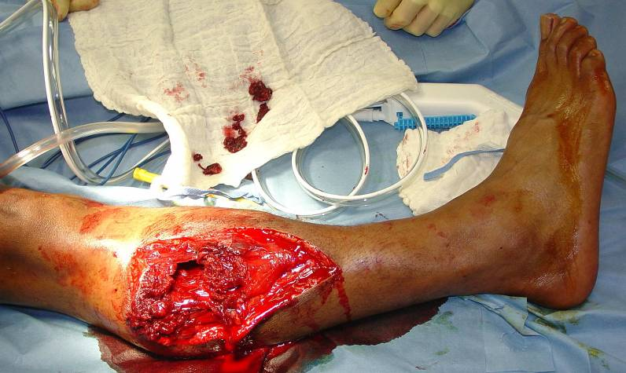
Soft Tissue and Bone Injury
Notes:
Coppola

Slide 44
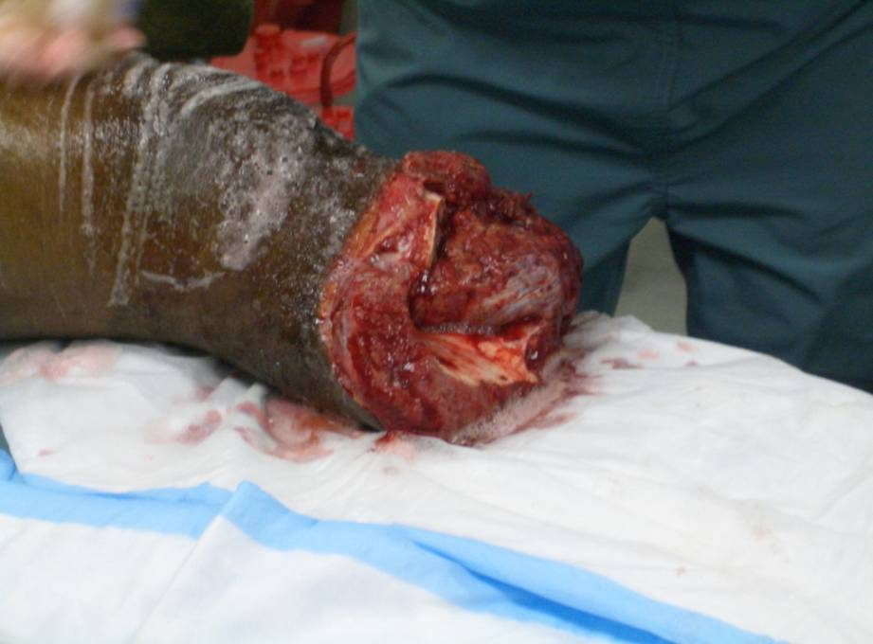
Notes:
Coppola

Slide 45
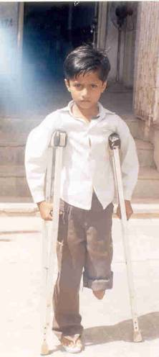
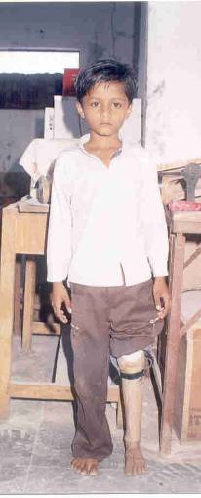
Rehabilitation

Slide 46
Burn
Lund and Browder
Parkland Formula
Weight (kg) x % burn x 2-4cc = Total volume LR 24 hrs
      Give 1/2 total over first 8 hrs
      Give remaining 1/2 over next 16 hrs
  < 30 kg: LR + Maintenance Fluid (D5 LR)
Goal U.O. < 30kg: 1cc/kg/hr
≥ 30kg: 0.5cc/kg/hr
Bolus as needed

Slide 47
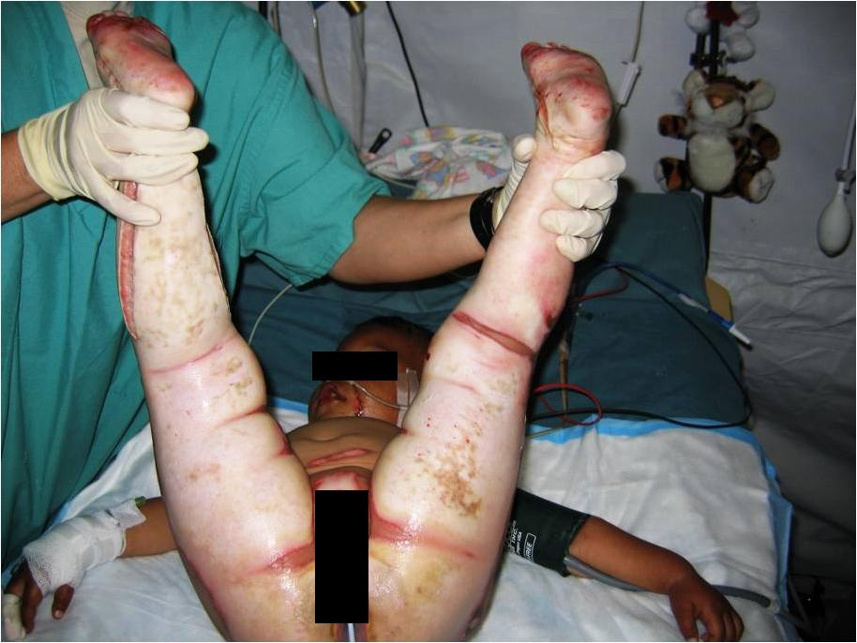
After debridement and escharotomy
Notes:
Coppola

Slide 48
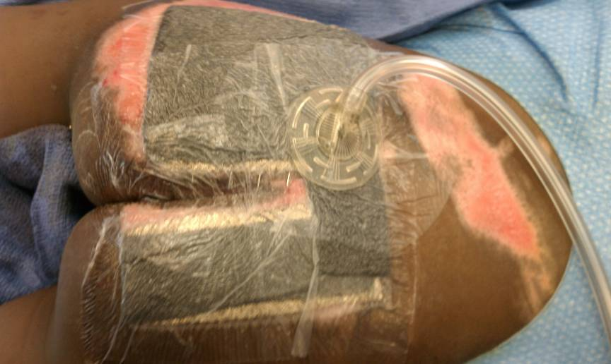
Notes:
48

Slide 49
Summary
Rapid resuscitation
Maintain BP with least amount of fluid
Operative care:
      Wide debridement
      Irrigation: all wounds
      Exploration: aggressive
      Pack all body spaces

Slide 50
Summary
Anticipate:
      Airway edema
      ARDS
      Abdominal Compartment Syndrome
      Fascial Compartment Syndrome
      Progressive necrosis

Slide 51

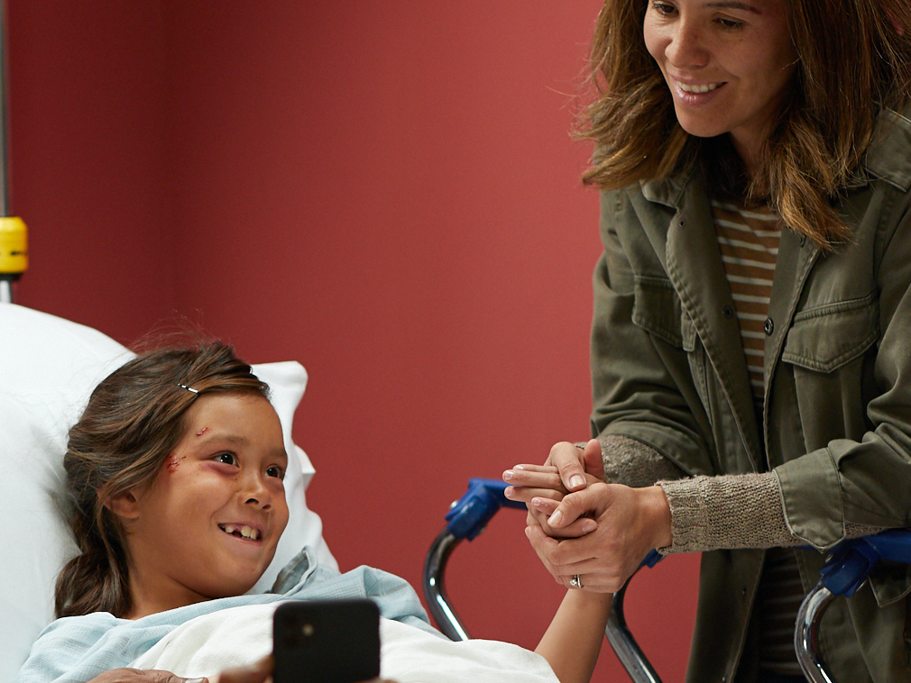
THANK YOU

Slide 52
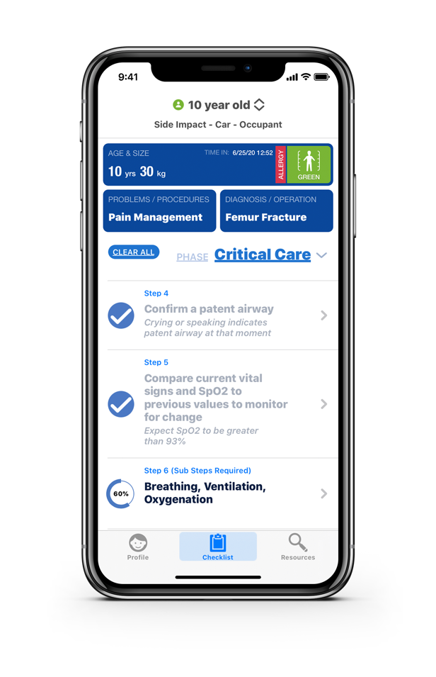
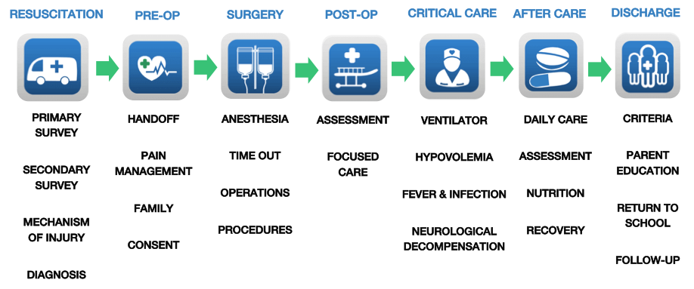
Triaj Solution
Best Practice Guidance Across the Continuum of Care

Slide 53
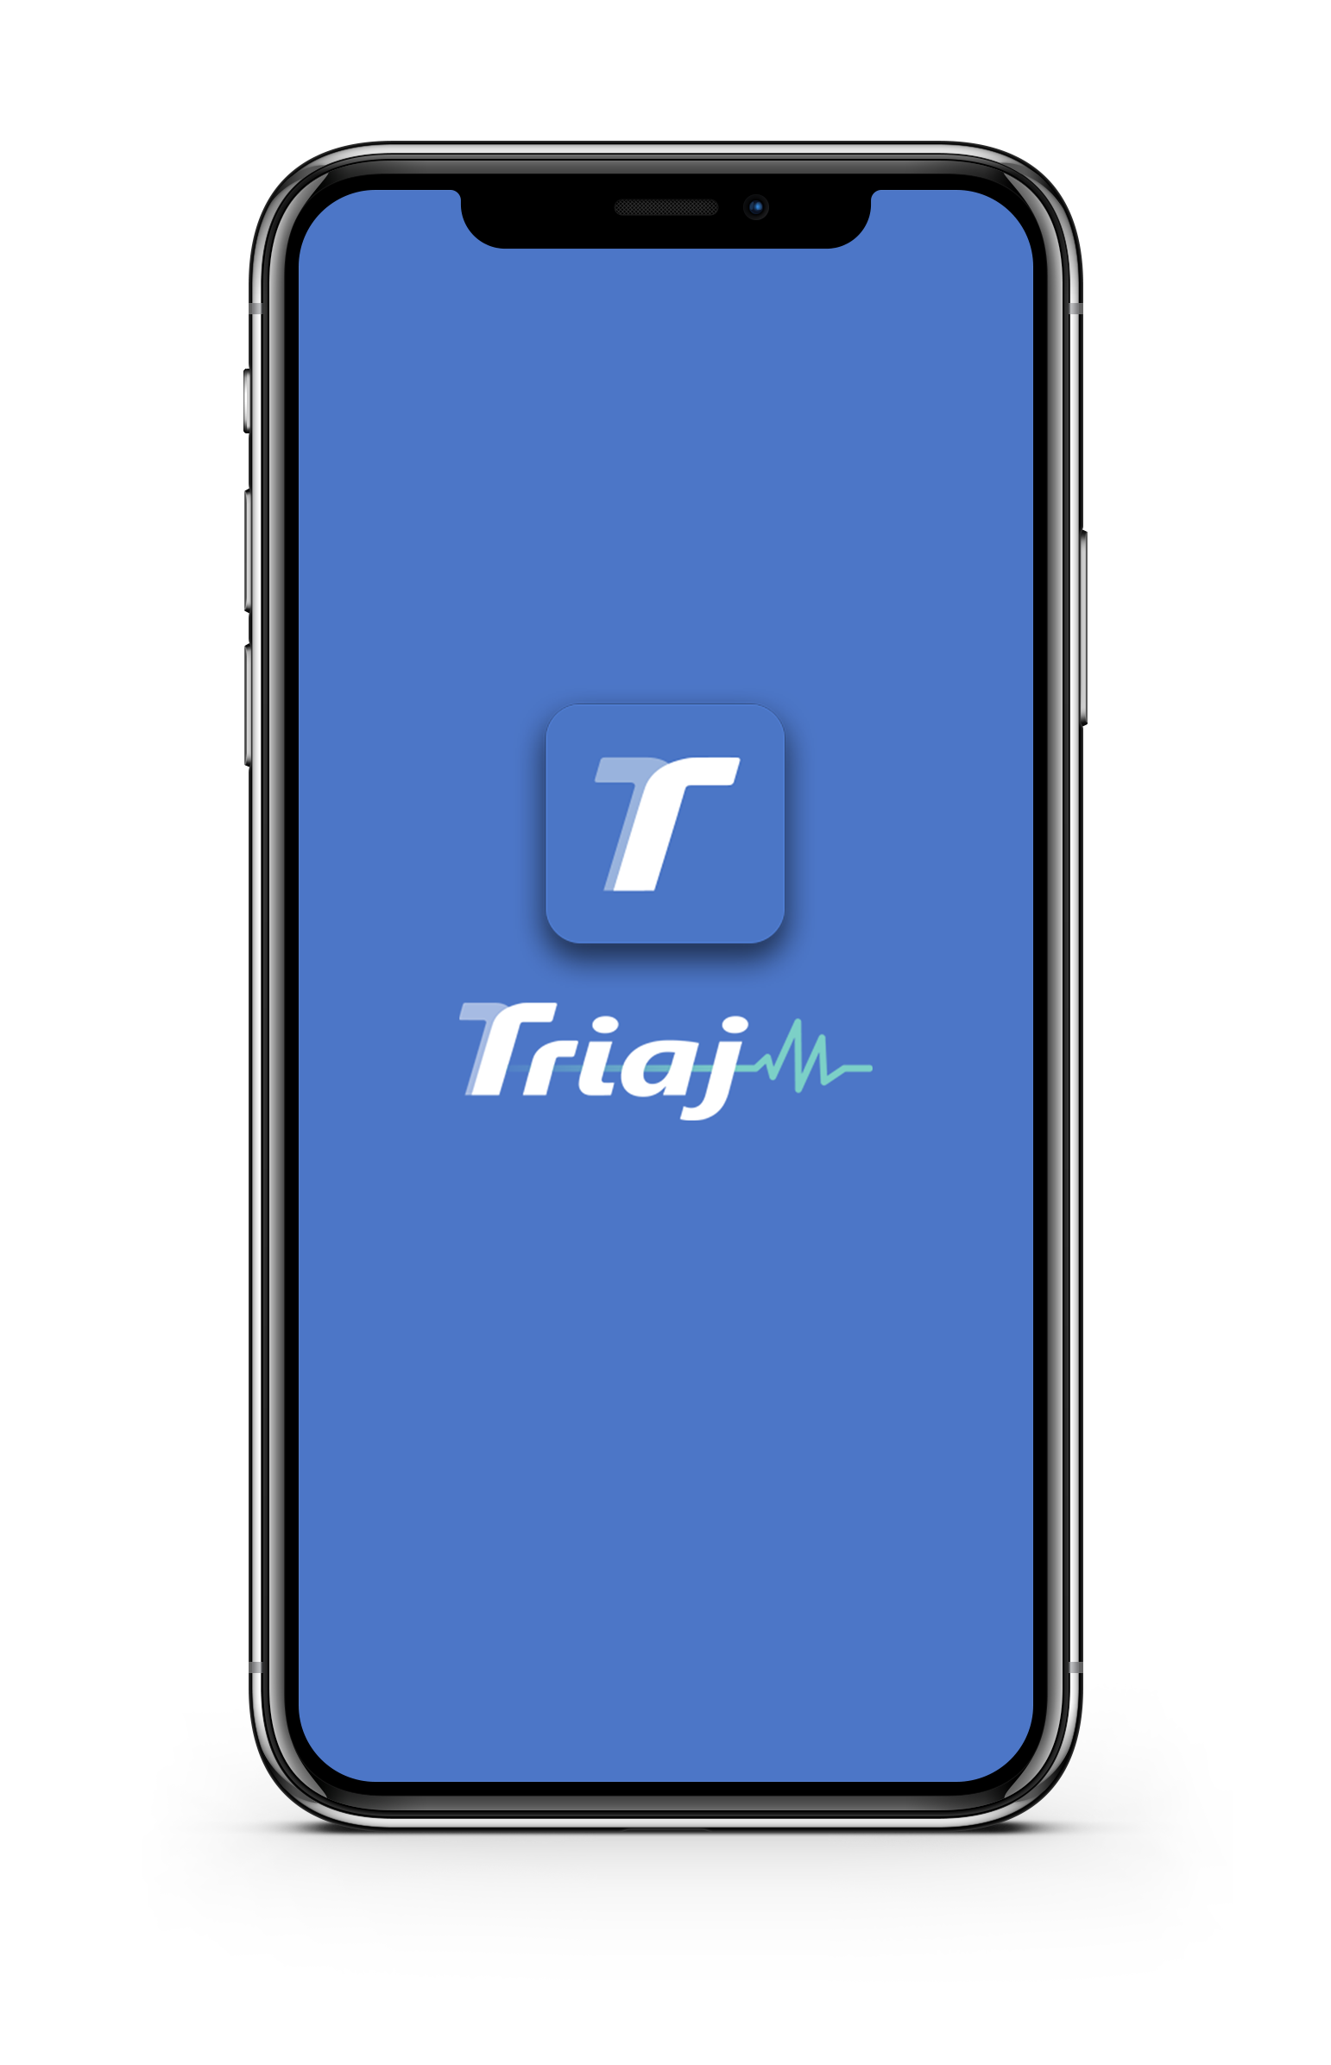
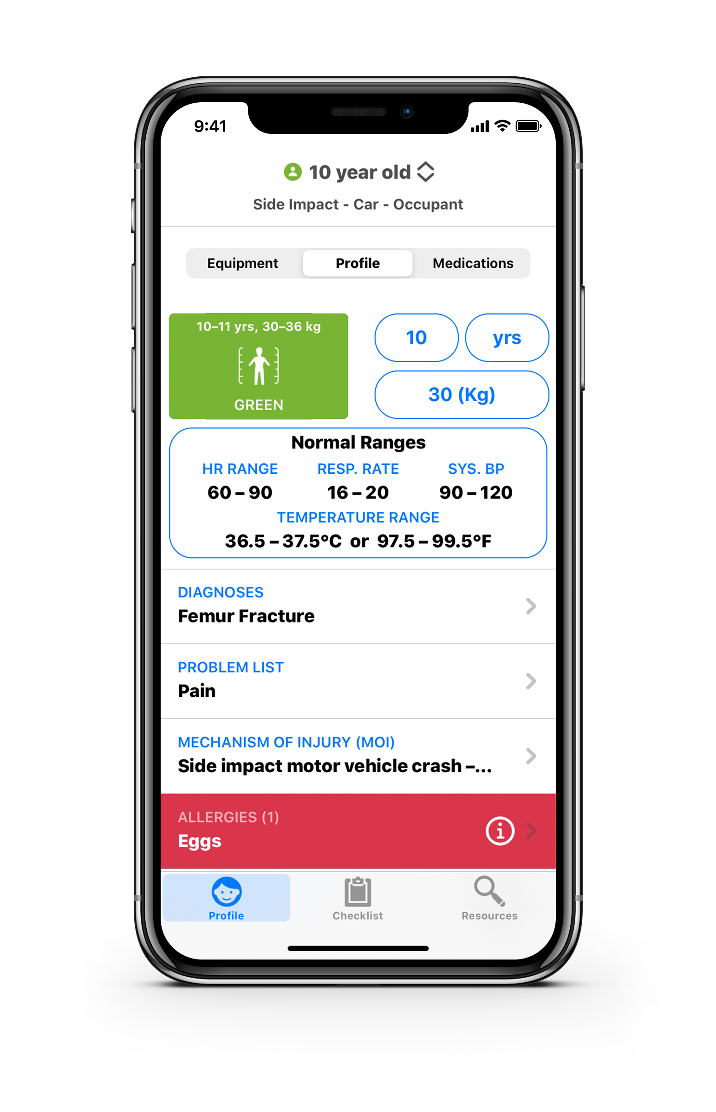




Saving Children’s Lives
To Learn More
About Triaj:
Email: PR@triaj.com
Website: www.triaj.com

Slide 54

Safe Kids Worldwide:
Notes:
54

